Slide 1
DECISION TREE INDUCTION
ENTROPY BASED

Slide 2
Attribute Selection: An Experiment
It was shown that the TDIDT algorithm is guaranteed to terminate and to give a decision tree that correctly corresponds to the data, provided that the adequacy condition is satisfied.
It was also pointed out that the TDIDT algorithm is underspecified.
Provided that the adequacy condition is satisfied, any method of choosing attributes will produce a decision tree.
We will start our discussion by considering the decision trees obtained from using some poorly chosen strategies for attribute selection.

Slide 3
Attribute Selection: An Experiment
First we look at the decision trees produced by using the three attribute selection strategies listed below.
  takefirst – for each branch take the attributes in the order in which they appear in the training set, working from left to right, e.g. for the degrees training set in the order SoftEng, ARIN, HCI, CSA and Project.
  takelast – as for takefirst, but working from right to left, e.g. for the degrees training set in the order Project, CSA, HCI, ARIN and SoftEng.
  random – make a random selection (with equal probability of each attribute being selected).
Notes:
Warning: these three strategies are given here for purposes of illustration only. They are not intended for serious practical use but provide a basis for comparison with other methods introduced later.

Slide 4
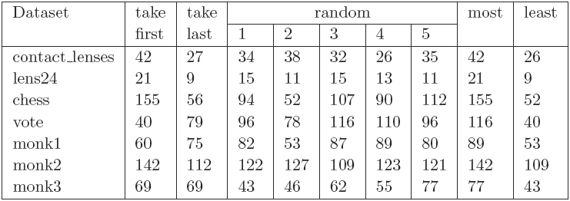
Attribute Selection: An Experiment
Table below shows the results of running the TDIDT algorithm with attribute selection strategies takefirst, takelast and random in turn to generate decision trees for the seven datasets contact lenses, lens24, chess, vote, monk1, monk2 and monk3.

Slide 5
Attribute Selection: An Experiment
The random strategy was used five times for each dataset. In each case the value given in the table is the number of branches in the decision tree generated. The last two columns record the number of branches in the largest and the smallest of the trees generated for each of the datasets.

Slide 6
Attribute Selection: An Experiment
In all cases there is a considerable difference. This suggests that although in principle the attributes can be chosen in any arbitrary way, the difference between a good choice and a bad one may be considerable.

Slide 7
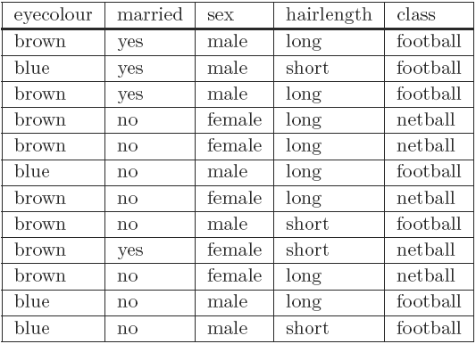
The Football/Netball Example
A fictitious university requires its students to enroll in one of its sports clubs, either the Football Club or the Netball Club. It is forbidden to join both clubs. Any student joining no club at all will be awarded an automatic failure in their degree.
What determines who joins which club?

Slide 8
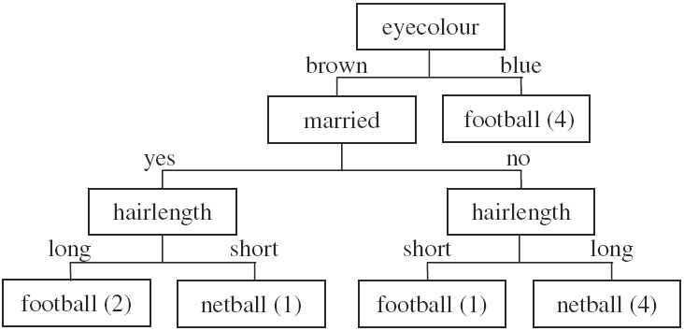
The Football/Netball Example

Slide 9
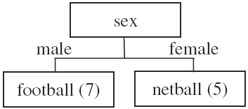
The Football/Netball Example

Slide 10
The Football/Netball Example
Which one is correct?
It is best to avoid using terms such as ‘correct’ and ‘incorrect’ in this context.
All we can say is that both decision trees are compatible with the data from which they were generated.
The only way to know which one gives better results for unseen data is to use them both and compare the results.

Slide 11
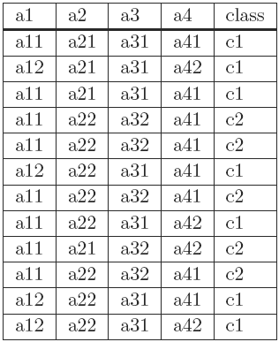
The anonymous Dataset
Now consider a different dataset. Here we have a training set of 12 instances. There are four attributes, a, a2, a3 and a4, with values a11, a12 etc., and two classes c1 and c2.
One possible decision tree?

Slide 12
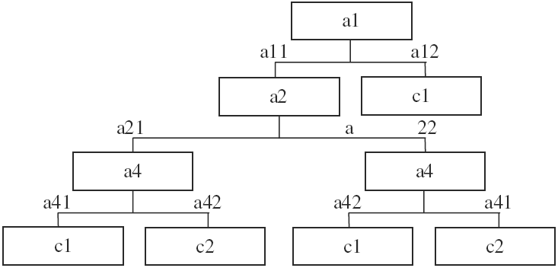
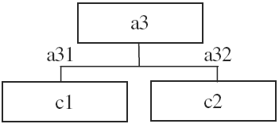
The anonymous Dataset

Slide 13
The anonymous Dataset
Data mining algorithms generally do not allow the use of any background knowledge the user has about the domain from which the data is drawn, such as the ‘meaning’ and relative importance of attributes, or which attributes are most or least likely, to determine the classification of an ins
It is easy to see that a decision tree involving tests on eyecolour, hairlength etc. is meaningless when it is given in isolation, but if those attributes were part of a much larger number (possibly many thousands) in a practical application what would there be to prevent meaningless decision rules from being generated?
The quality of the strategy used to select the attribute to split on at each stage is clearly of vital importance. This is the topic to which we now turn.

Slide 14
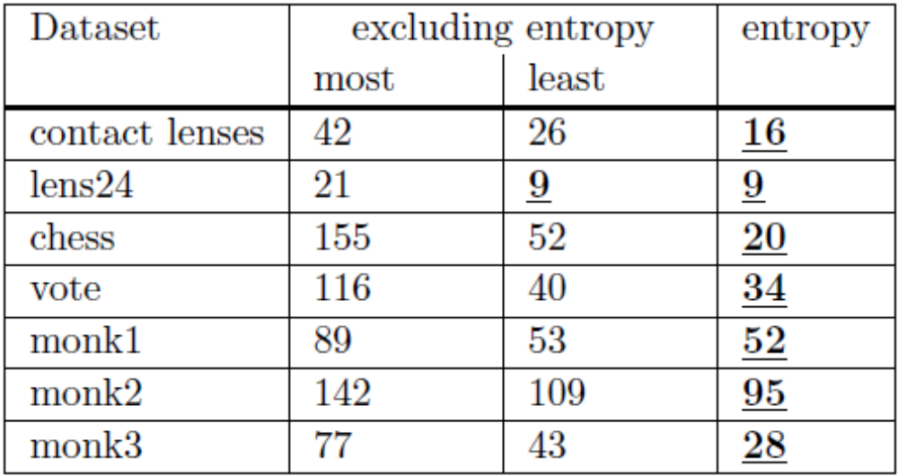
Entropy
One commonly used method is to select the attribute that minimises the value of entropy, thus maximising the information gain.

Slide 15
Why Entropy/Information Gain
In all cases the number of rules in the decision tree generated using the ‘entropy’ method is less than or equal to the smallest number generated using any of the other attribute selection criteria introduced so far. In some cases, such as for the chess dataset, it is considerably fewer.
There is no guarantee that using entropy will always lead to a small decision tree, but experience shows that it generally produces trees with fewer branches than other attribute selection criteria. Experience also shows that small trees tend to give more accurate predictions than large ones, although there is certainly no guarantee of infallibility.

Slide 16
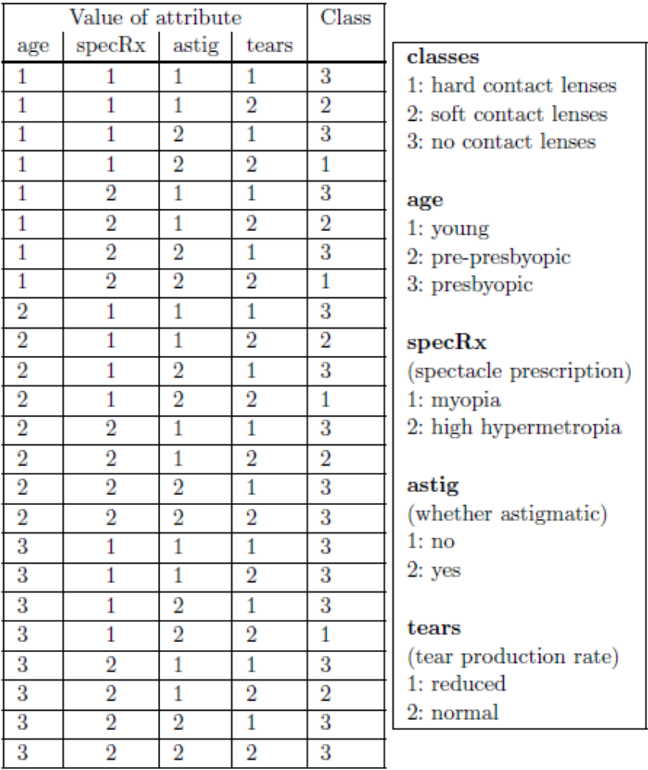
Lens24 Dataset
The lens24 dataset is Ophthalmological data about contact lenses.
Three classes 1, 2 and 3 - signifying respectively that the patient should be fitted with hard contact lenses, soft contact lenses or none at all

Slide 17
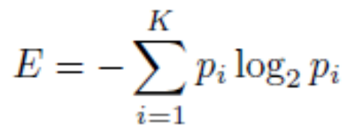
Information Gain
Information Gain, IG = E_{start} – E_{new}
E_{start} entropy of the training set, It is measured in ‘bits’ of information and is defined by the formula
E_{new} is calculated for each attribute
We get an attribute’s IG value by subtracting its E_{new} from E_{start}
Attribute with highest IG value is selected

Slide 18
Entropy
For the initial lens24 training set of 24 instances, there are 3 classes.
There are 4 instances with classification 1, 5 instances with classification 2 and 15 instances with classification 3.
So p1 = 4/24, p2 = 5/24 and p3 = 15/24.
E_{start} = −(4/24) log₂(4/24) − (5/24) log₂(5/24) − (15/24) log₂(15/24)= 0.4308 + 0.4715 + 0.4238 = ?

Slide 19
Select Attribute
The process of decision tree generation by repeatedly splitting on attributes is equivalent to partitioning the initial training set into smaller training sets repeatedly, until the entropy of each of these subsets is zero.
Splitting on any attribute has the property that the average entropy of the resulting subsets will be less than (or occasionally equal to) that of the previous training set.

Slide 20
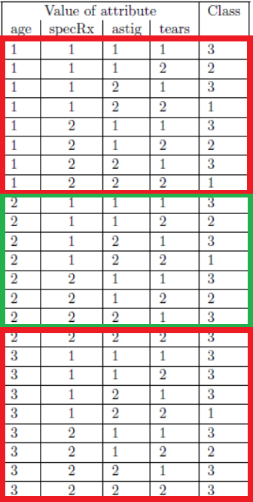
Splitting on Attribute
For the lens24 training set, splitting on attribute age would give three subsets as shown

Slide 21
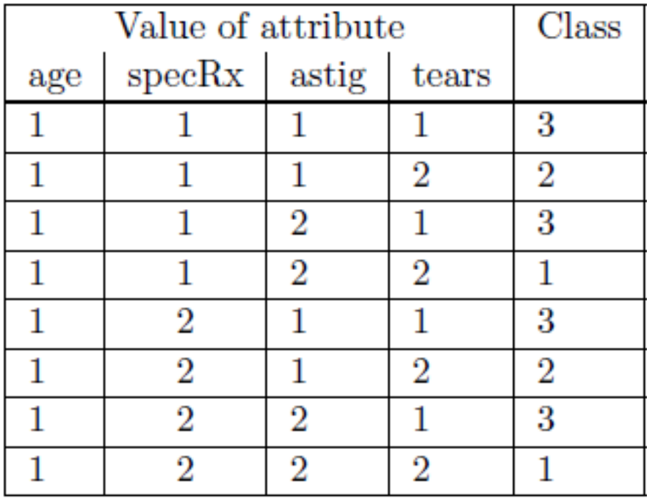
Splitting on Attribute
Age = 1
Entropy E1 = −(2/8) log₂(2/8) − (2/8) log₂(2/8) − (4/8) log₂(4/8) = 0.5 + 0.5 + 0.5 = 1.5

Slide 22
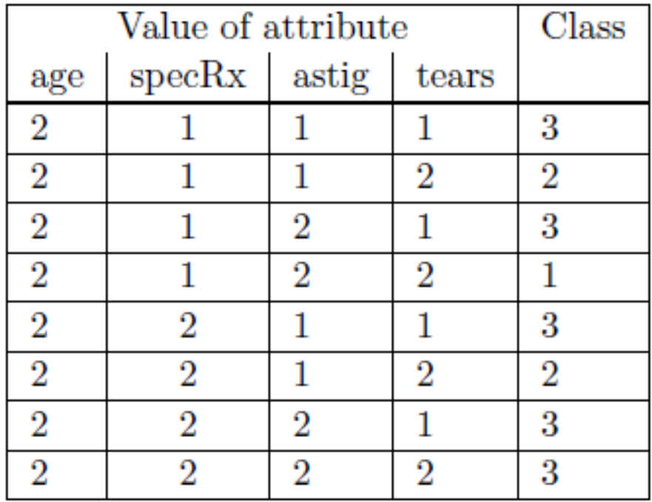
Splitting on Attribute
Age = 2
Entropy E2 = −(1/8) log₂(1/8) − (2/8) log₂(2/8) − (5/8) log₂(5/8) = 0.375 + 0.5 + 0.4238 = 1.2988

Slide 23
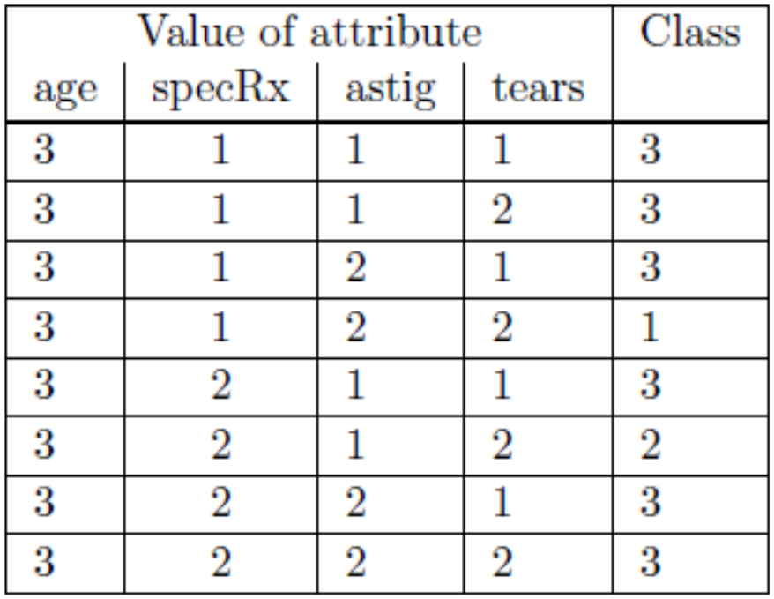
Splitting on Attribute
Age = 3
Entropy E3 = −(1/8) log₂(1/8) − (1/8) log₂(1/8) − (6/8) log₂(6/8) = 0.375 + 0.375 + 0.3113 = 1.0613

Slide 24
Splitting on Attribute
The values E1, E2 and E3 need to be weighted by the proportion of the original instances in each of the three subsets. In this case all the weights are the same, i.e. 8/24.
E_{new} = (8/24) E1+(8/24) E2+(8/24) E3 = 1.2867 bits (to 4 decimal places)
Information Gain = E_{start} − E_{new}
Information gain from splitting on attribute age is 1.3261 − 1.2867 = 0.0394 bits
The ‘entropy method’ of attribute selection is to choose to split on the attribute that gives the greatest reduction in (average) entropy, i.e. the one that maximises the value of Information Gain. This is equivalent to minimizing the value of E_{new} as E_{start} is fixed.

Slide 25
Splitting on Attribute
attribute age
E_{new} = 1.2867, Information Gain = 1.3261 − 1.2867 = 0.0394 bits
attribute specRx
E_{new} = 1.2866, Information Gain = 1.3261 − 1.2866 = 0.0395 bits
attribute astig
E_{new} = 0.9491, Information Gain = 1.3261 − 0.9491 = 0.3770 bits
attribute tears
E_{new} = 0.7773, Information Gain = 1.3261 − 0.7773 = 0.5488 bits

Slide 26
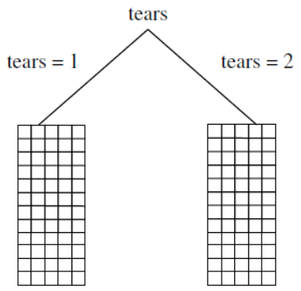
Splitting on Attribute
Thus, the largest value of Information Gain (and the smallest value of the new entropy E_{new}) is obtained by splitting on attribute tears.
The process of splitting on nodes is repeated for each branch of the evolving decision tree, terminating when the subset at every leaf node has entropy zero.

